Slide 1
SCREEN -1
LOGIN
Facebook ID
PWD
password
SUBMIT

Slide 2
SCREEN - 2
Loading . . .

Slide 3
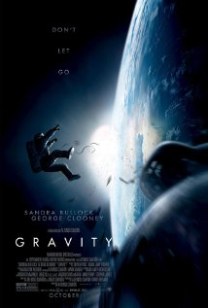
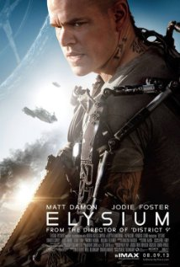
SCREEN -3
Welcome Sam
Movies you liked
Movies friends liked
Gravity (2013)
Director: Alfonso Cuarón
Elysium (2013)
Director: Neill Blomkamp

Slide 4
SCREEN- 4
GRAVITY (2013)
A medical engineer and an astronaut work together to survive after an accident leaves them adrift in space.
Director: Alfonso Cuarón
REVIEWS :
Friends
If ever there was a case to be made for 3-D as a valuable cinematic tool, Alfonso Cuaron has made it. Put alongside Avatar and Hugo (with honorable mentions going to Prometheus and Life of Pi), Gravity shows the power of 3-D when applied effectively and with vision. The immersive quality is undeniable and in some ways indefinable. Cuaron's stated goal with Gravity is to put the viewer in space with the characters and he accomplishes this.

